Slide 1
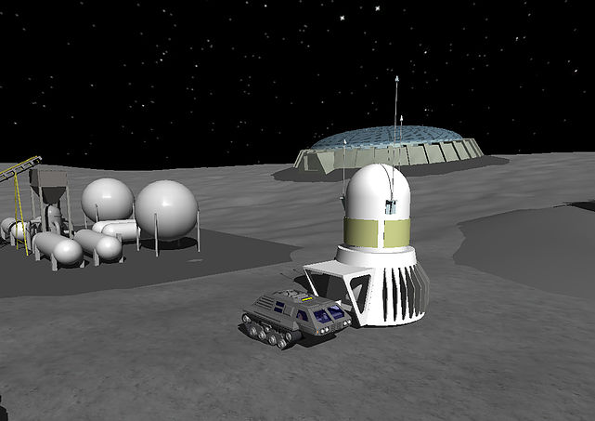
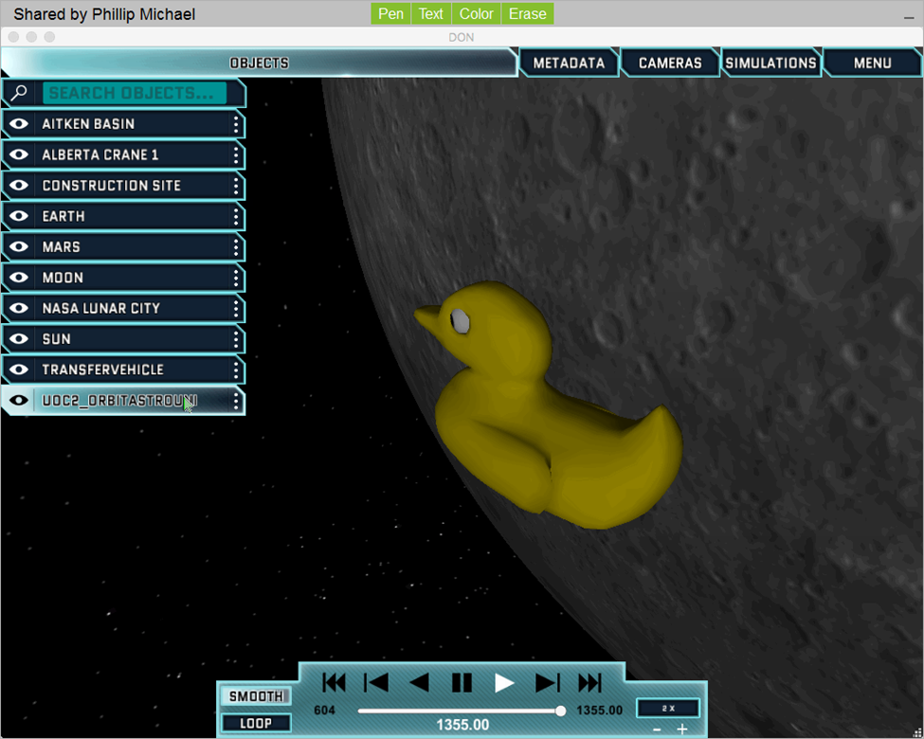
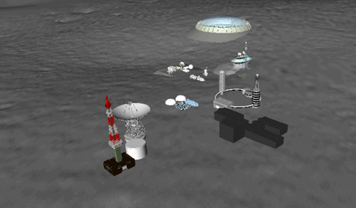
When asteroids attack
A simulated nasa lunar mission
Midwestern State University
Anthony Enem • Amy Knowles • Christine Mounce • Chris Silva
Faculty Advisor: Dr. Bingyang Wei

Slide 2
outline
Simulation Exploration Experience (SEE)
Teams Participating
High Level Architecture (HLA)
A Better Understanding
HLA Services
Systems Tool Kit (STK)
When Asteroids Attack

Slide 3
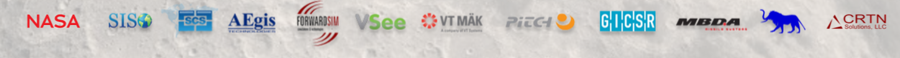
Simulation exploration experience (SEE)
What is SEE?
Led by NASA, SEE joins students, industry, associations, and faculty for a collaborative college-level modeling and simulation learning experience.
Inter-university teams design, develop, test and execute a simulated lunar mission.
Who created and contributed to SEE?
The idea of SEE originated with NASA engineer Zack Crues and has been implemented by NASA and SISO Space Community Forum.
Industry Members: FowardSim, VT MAK, AEgis, MBDA, Pitch, VSEE
Professional Associations: SISO, Liophant, SCS, GICSR
Government: NASA

Slide 4
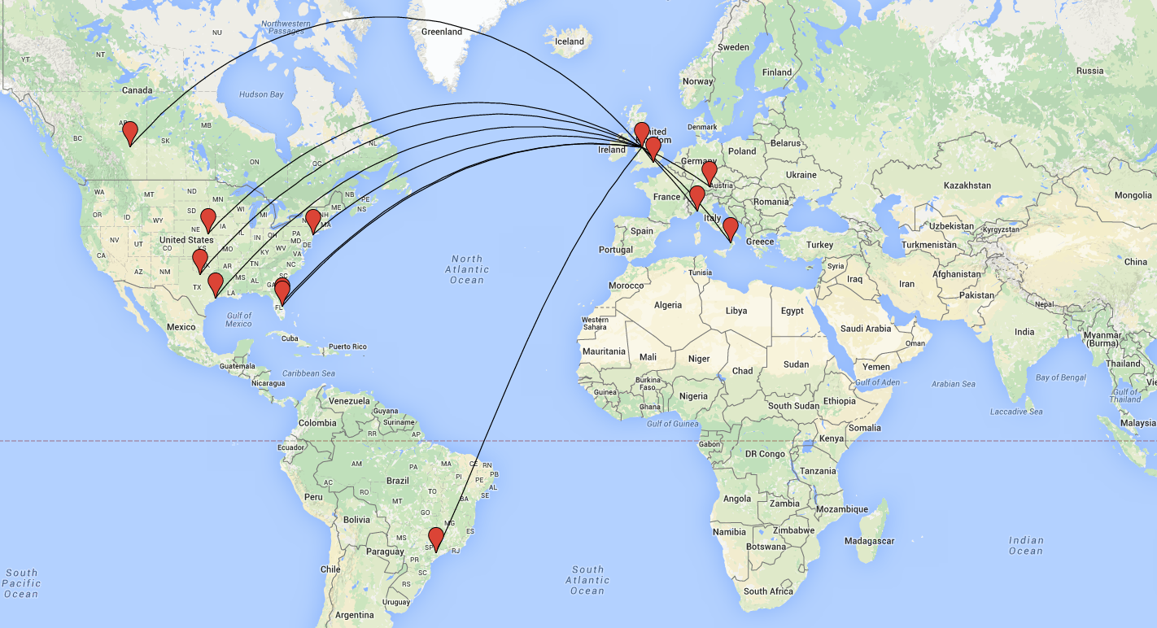
Team participation
Participating Teams
Munich University Cal Poly, University of Bordeaux, Brunel, University of Nebraska, Liverpool, University of Calabria (2 Teams), FACENS Brazil, Florida Institute of Technology, Genoa (2 teams), Alberta, Midwestern State University, Stevens Institute of Technology

Slide 5
High Level Architecture (HLA)
Enables several simulation systems to work together seamlessly
Does not rely on all simulations using the same programming language
Each simulation system can work together or by itself
The standard architecture for all Department of Defense simulations

Slide 6
HLA terminology
Runtime Infrastructure (RTI) – A piece of software that provides the HLA services.
Federate – A system that connects to the RTI and can model any number of objects in a simulation
Federation Object Model (FOM) – A file that contains a description of the data exchange in a Federation
Federation – All of the federates along with the RTI and the FOM that they use
Federation Execution – An instance of the federation

Slide 7
RTI Software
Pitch Technologies – pRTI
The Viking Exercise series
ATV-2 ISS docking training
Swedish Air Combat Simulation Centre
NATO Modeling and Simulation Groups
NH90 training simulation
Single European Sky simulation project
VT Mäk – Mäk RTI
US Air Force Joint Strike Fighter program
US Air Force Distributed Mission Operations
NATO's First WAVE exercise
US Navy DDG 1000 program
Canada's Department of National Defense War in a Box program
US Marine Corps Tactical Environment Network
US Army Virtual Proving Ground SEIT Demonstration

Slide 8
Connecting
Local RTI Component (LRC)
A local library installed on each computer with a federate. “dll” file for C++ federates, “jar” for java.
Central RTI Component (CRC)
An application that coordinates the federation execution and keeps track of the joined federates.
Must be started before any federate can join a federation

Slide 9
HLA Services (standardized APIs)
To use these services a federate will make calls to the RTI and receive callbacks from the RTI, which means that there is a two-way communication
The data exchanged between federates are object attributes and interactions
Publish and Subscribe
Update and Reflect Attribute Values
Send and Receive Interactions
Notes:
These services enable federates to exchange data according to the FOM using a Publish/Subscribe scheme.

Slide 10



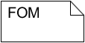
HLA Services: Publish and subscribe
Publish
PhysicalEntity.entity_name, PhysicalEntity.parent_reference_frame, PhysicalEntity.position
Subscribe
PhysicalEntity.entity_name, PhysicalEntity.parent_reference_frame
PhysicalEntity.position
o₁
o₄
o₂
o₅
Time management
Visualization
Logging
o₇
o₈
o₃
o₆
f₁
f₂
f₃
f₄
Publish
Subscribe
PhysicalEntity.entity_name, PhysicalEntity.parent_reference_frame
PhysicalEntity.position
Runtime Infrastructure (RTI)
Notes:
The RTI keeps track of which federates subscribe to a certain type of data, which means that the federates want to receive that type of data. It also keeps track of which federates publish each type of object, attribute, or interaction, which means that they are able to send that type of data. Finally the RTI acts like a switchboard and delivers data from publishers to subscribers.

Slide 11
HLA Services: Updating and Reflecting Attribute Values
Publish
PhysicalEntity.entity_name, PhysicalEntity.parent_reference_frame, PhysicalEntity.position
UpdateAttributeValues
o₁
o₄
o₂
o₅
Time management
Visualization
Logging
o₇
o₈
o₃
o₆
f₁
f₂
f₃
f₄
Subscribe
PhysicalEntity.entity_name, PhysicalEntity.parent_reference_frame
PhysicalEntity.position
ReflectAttributeValues
Runtime Infrastructure (RTI)
Notes:
Only a federate has published, how does it notify others to receive updates?
A federate does not have to worry about how to deliver or whether or not a federate receives or when it receives, this is taken care of by RTI.
This slide tells you how to work with attribute values for object instances. This includes both sending and receiving values.
The UpdateAttributeValues is used to send an update for a set of attributes for a specific object instance
Updates are typically sent when the value has changed or when another federate needs and update.
Your federate receives the ReflectAttributeValues with updated attribute values for attributes that is subscribes to
This callback is invoked on your federate when another federate requests the most recent value of an attribute of one of your object instances. This request is performed automatically by the RTI on behalf of a federate that discovers a new object instance

Slide 12

Systems Tool Kit (STK)
STK Components from Analytical Graphics Inc. (AGI)
It is a collection of development libraries that simplify everything.
Use STK Components because it is very lightweight and easy to utilize and implement
STK is faster than other options and more affordable for large scale projects

Slide 13
More STK
In our federate we used the following STK libraries
Communications
Graphics
Models
Orbit Propagation
Terrain Readers

Slide 14

Launch day
Date: March 23, 2016
Where: Liverpool, England
When: 4:00 pm UTC (11:00 AM CST)
VSEE Video Chat

Slide 15
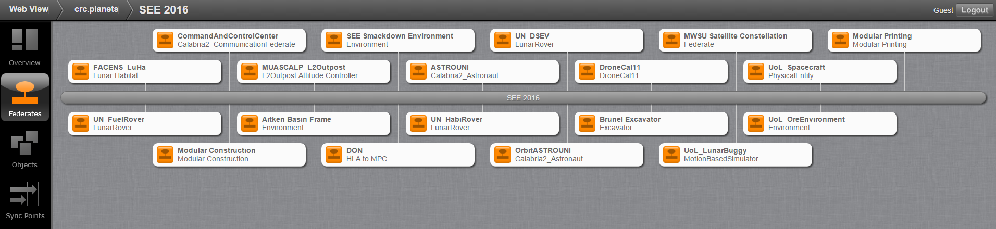
Federates
19 Federates: Highest number of federates in a SEE event to date!!

Slide 16
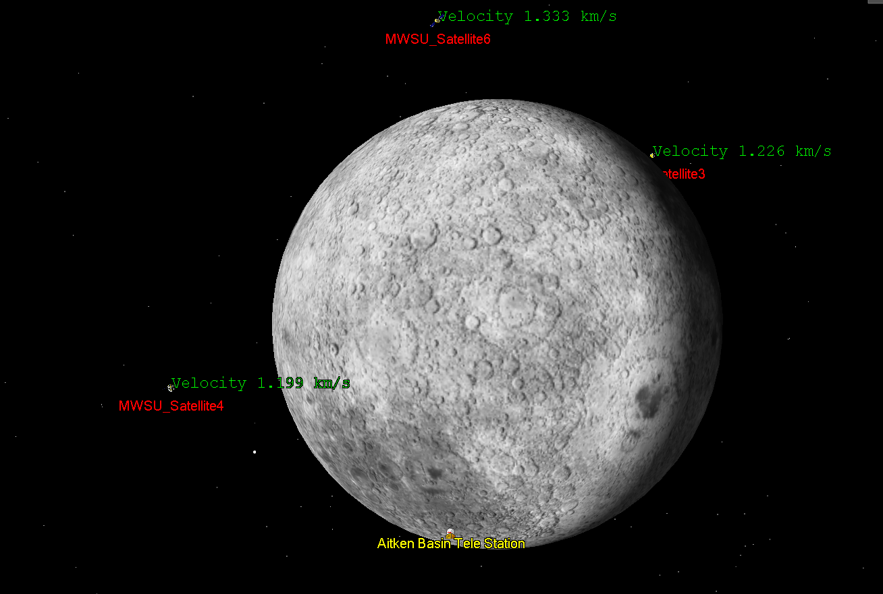
Team MWSU
Satellite Communication Network
Received signal of incoming asteroid
Relayed signal to Liverpool’s Lunar Buggy

Slide 17
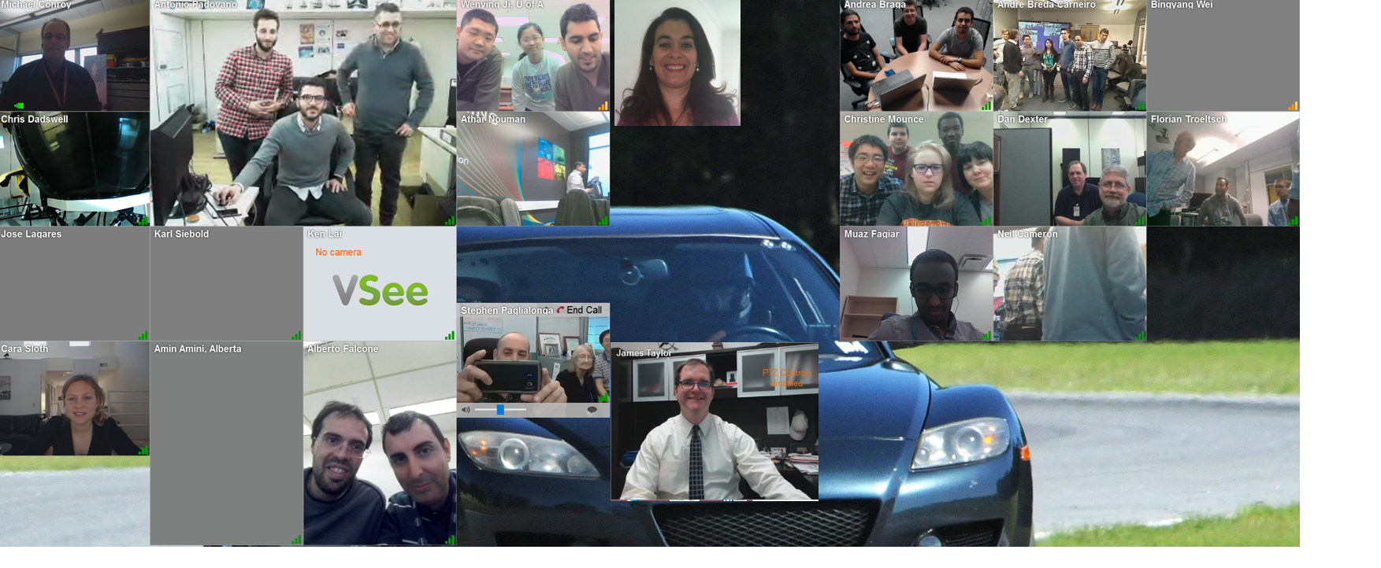
conclusion

Slide 18
References
Modelling, Simulation and Design Lab. School of Computer Science of McGill University, Montreal, Quebec, Canada. http://msdl.cs.mcgill.ca/
Back to the Moon – an HLA-based Distributed Simulation of Lunar Exploration Mission by Dr Binyang Wei, Midwestern State University

